Slide 1

An Introduction to Client Web Enablement Toolkit
Andrew Jan

Slide 2
Client Web Enablement Toolkit
Starting from z/OS V2.2 (and available in z/OS V2.1 with service updates)
IPL console message:
Built into the base of z/OS, the toolkit provides an easy-to-use, lightweight, high function and secure solution for applications to ack as a client of web services
Programs running as batch jobs, started procedures or almost any type of address space on a z/OS system now have native APIs that they can use in a similar manner to any standard z/OS APIs
Programming languages that are supported include C/C++, COBOL, PL/I, Assembler language and REXX.

Slide 3
JSON & HTTP(S) APIs
z/OS JSON parser:
Parses JSON text coming from any source
Builds new JSON text
Adds data to existing JSON text.
z/OS HTTP/HTTPS protocol enabler:
Uses interfaces similar in nature to other industry-standard APIs.
The intention of the toolkit is to enable traditional z/OS programs apart from a Java Virtual Machine (JVM) environment to have easy access to these types of services.
Part 9 in Callable Services for High-level Languages (ieac100_v2r4.pdf)
Chapter 20. The z/OS JSON Parser
Chapter 21. The z/OS HTTP/HTTPS Protocol Enabler
https://www-40.ibm.com/servers/resourcelink/svc00100.nsf/pages/zOSV2R4sa231377?OpenDocument

Slide 4
Potential Benefits
Using restful APIs anywhere in legacy code residing in application or system to transport data from mainframe to the outside world (POST or PUT) and the other way around (GET)
Actively initiating data exchanges on the mainframe side
For huge trunks of data, the STREAMING option may be used:
HWTH_OPT_STREAM_SEND_EXIT (outbound to OPEN)
HWTH_OPT_STREAM_RECEIVE_EXIT (inbound to MF)
If coding is inevitable while building solutions, then this z/OS embedded feature probably be one of the solutions to choose from.

Slide 5
General coding sequence for JSON parser
Create a parser instance and obtain the parser handle (HWTJINIT).
Associate JSON text with the parser instance and create an internal representation of the data for fast access by subsequent services (HWTJPARS) or create new JSON text from scratch (HWTJCREN).
Traverse to discover the contents of the JSON text, or search to find a particular name in a name or value pair (HWTJSRCH) or add or insert new entries into the existing JSON text (HWTJCREN) or some combination of all of these services.
Build the new JSON text if any text was added (HWTJSERI).
Free storage used by the parser services (HWTJTERM).

Slide 6
General coding sequence for HTTP(S) services
Create a connection instance, which returns a connection handle. (HWTHINIT)
Set the necessary connection options, such as URI of the server, SSL options, and so on, associated with this connection instance. (HWTHSET)
Connect to the server. (HWTHCONN)
Create a request instance, which returns a request handle. (HWTHINIT)
Set the necessary request options, such as the request type, server resource, HTTP response callback exits, and so on, associated with this request instance. (HWTHSET)
Send the previously defined request over the previously defined connection. If configured by the application, HTTP response routines are called during this service call to process the response data. (HWTHRQST)
Disconnect the previous connection. (HWTHDISC)
Free the work area associated with the request. (HWTHTERM)
Free the work area associated with the connection. (HWTHTERM)

Slide 7
Sample Code for HTTP Enabler in SYS1.SAMPLIB
z/OS 2.2
HWTHXCB1 (COBOL) GET from http://services.faa.gov/airport/status/ with HWTHSLST
HWTHXC1 (C) GET from http://services.faa.gov/airport/status/ with HWTHSLST
HWTHXPI1 (PL/I) GET from http://services.faa.gov/airport/status/ with HWTHSLST
HWTHXRX1 (REXX) GET from http://services.faa.gov/airport/status/ with HWTHSLST
z/OS 2.4
HWTHXCB1 (COBOL) GET from http://example.org/
HWTHXCB2 (COBOL) POST to http://httpbin.org/post using STREAMING SEND & RECEIVE
HWTHXC1 (C) GET from http://example.org/
HWTHXC2 (C) POST to http://httpbin.org/post using STREAMING SEND & RECEIVE
HWTHXPI1 (PL/I) GET from http://example.org/
HWTHXRX1 (REXX) GET from http://example.org/

Slide 8
Sample Code for JSON Parser in SYS1.SAMPLIB
z/OS 2.2
HWTJXCB1 (COBOL)
HWTJXC1 (C)
HWTJXPI1 (PL/I)
HWTJXRX1 (REXX)
z/OS 2.4 adds
HWTJXCB2 (COBOL)
HWTJXC2 (C)
HWTJXRX2 (REXX)
HWTJXRX3 (REXX) iconv thru bpxwunix
HWTJSPRT (REXX)
Pretty-print JSON string a REXX can issue call bpxwunix ‘/samples/hwtjsprt’ … See the example under HWTJSERI in the manual
HWTCONST - Initialize REXX predefined variables (REXX)
HWTJINIT - Initialize a parser instance.
HWTJTERM - Terminate a parser instance.
HWTJPARS - Validate a JSON string & Prepare it for next actions.
HWTJCREN - Create/Insert a JSON entry into an existing JSON.
HWTJSERI - Serialize(Build) existing parser instance into JSON text.
HWTJSRCH - Find a particular name string in the JSON text.
HWTJGAEN - Retrieve a handle to an array entry.
HWTJGBOV - Get the value of a Boolean object type.
HWTJGJST - Get the JSON type with a specified handle.
HWTJGNUE - Get the number of entries in a JSON object.
HWTJGNUV - Get the binary representation of a number (non-REXX)
HWTJGOEN - Retrieve a handle to a JSON object entry.
HWTJGVAL - Get the value of the specified JSON object.
HWTJGENC(2.4) - Determine the character encoding.
HWTJSENC(2.4) - Set the character encoding.
HWTJESCT(2.4) - Encode/Decode escape sequences in a JSON text (REXX)
HWTJDEL(2.4) - Delete a JSON entry

Slide 9
Samples on the web
https://github.com/IBM/zOS-Client-Web-Enablement-Toolkit
A sample of REXX to use z/OSMF job status REST API and a simple AT-TLS policy sample
A sample of REXX code to transfer data (via POST) to SLACK
A sample of C code using GET (thru streaming) to receive data from https://httpbin.org/bytes/10000 (or other webs) to a sequential data set or a zFS file.
A sample of REXX code using HTTPS & JSON APIs to get the distance between two cities from accessing: http://api.geosvc.com/rest/....
An updated COBOL from the z/OS 2.2 SYS1.SAMPLIB(HWTHXCB1) that uses http://www.airport-data.com/api/ap_info.json?iata=LAX instead of http://services.faa.gov/airport/status/

Slide 10
Workshop Environment
OS: z/OS 2.2 & z/OS 2.4
IP: 10.1.1.2
RACF Keyring: CLNTWEB containing data that is in essence exact ca-cert.pem
HTTP(S) Client programs in Batch mode
OS: Win 10 on T14
IP: 10.1.1.1
Port: 3000 for HTTPS Port: 3001 for HTTP
SSL: ca-cert.pem server-cert.pem (public) server-key.pem (Private) 3 in 1: server-cert.p12
Path: /api/data
HTTP(S) Server programs
POST
Client
Server
Simple JSON texts are hard-coded in the programs
To overcome the network problems, a z/OS VM is used.
Client programs on z/OS are written in REXX, C, COBOL, PL/I and Assembler using Client Web APIs. Also the comparable JAVA programs.
We will use Open Liberty to run the JAVA code as the HTTP(S) server and print the received POST JSON on console
There are also server code in JAVA SE, Node.JS, Python, C# (only HTTP) and client code in JAVA, Javascript, Python and C# on Windows as a comparison to those programs on the mainframe.

Slide 11
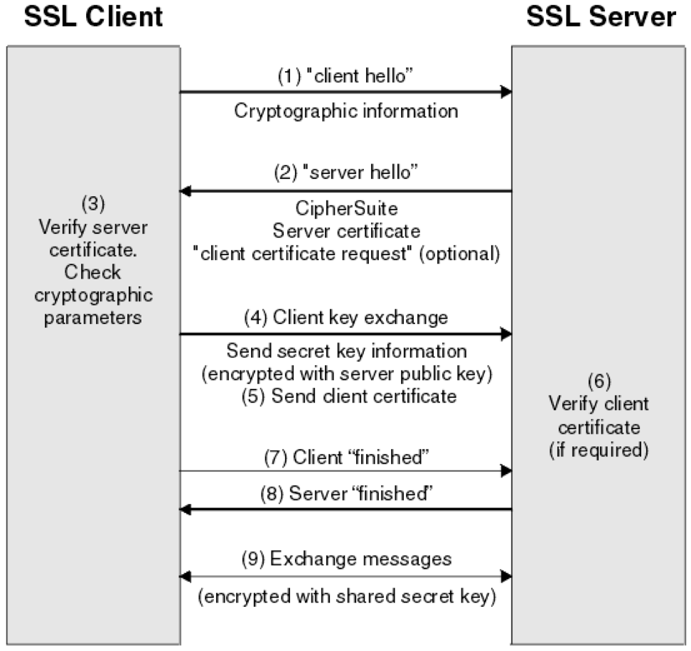
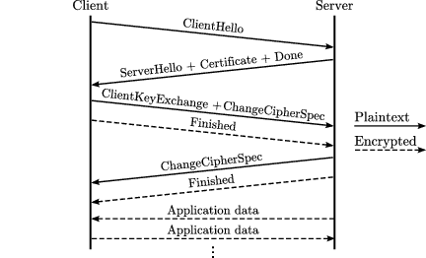
SSL Handshaking -- HTTPS vs HTTP

Slide 12
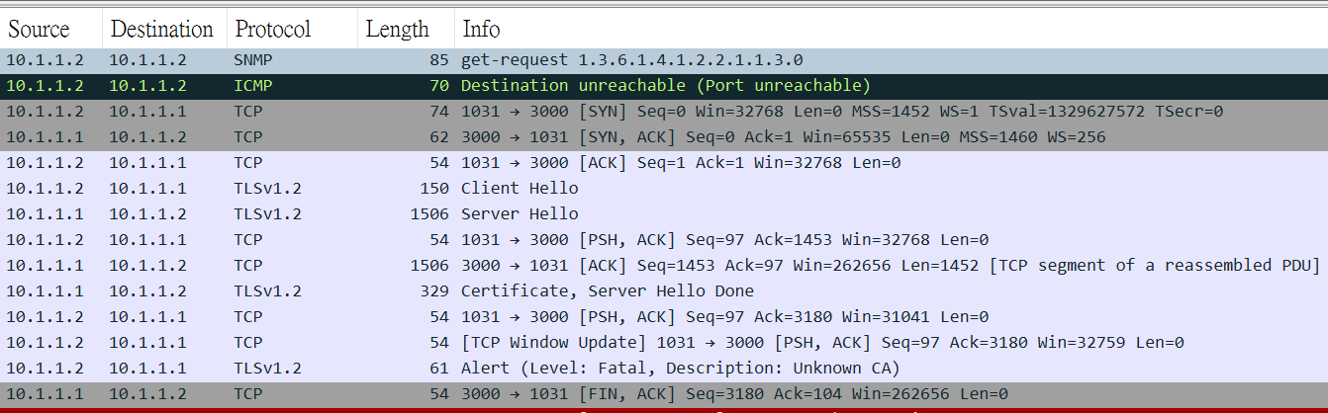


SSL Handshaking Failed
A 4096Bit CA Key is not supported by RACF

Slide 13
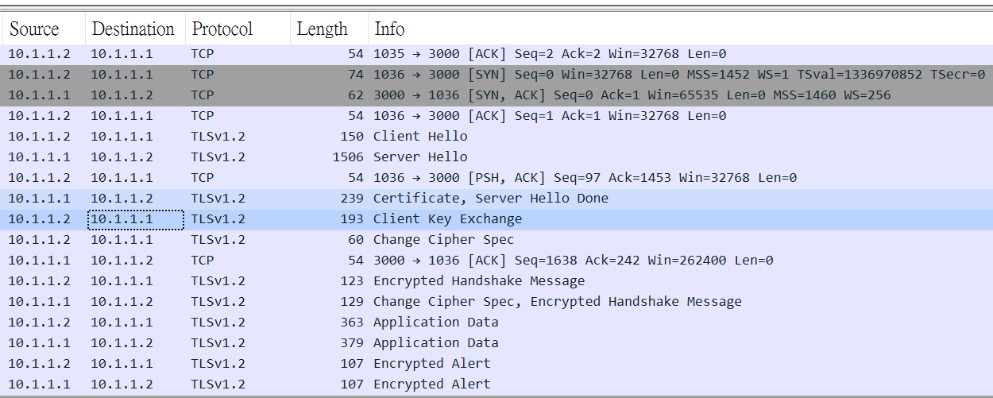
SSL Handshaking succeeded

Slide 14
TCPIP Packet Trace (1)
A started PROC: TCPIPT
//TCPIPT PROC //IEFPROC EXEC PGM=ITTTRCWR //TRCOUT01 DD DSN=SYS1.TRACE,DISP=SHR
RACF Definition RDEF STARTED TCPIPT.* STDATA(USER(IBMSYSID)) SETR REFRESH RACLIST(STARTED) RL STARTED TCPIPT.* STDATA
Issuing MVS commands
V TCPIP,,PKT,ON,FULL,IP=10.1.1.1,SRCP=3000
V TCPIP,,PKT,ON,FULL,IP=10.1.1.2
TRACE CT,WTRSTART=TCPIPT
TRACE CT,ON,COMP=SYSTCPDA,SUB=(TCPIP)
R xx,WTR=TCPIPT,END
……………… collecting data in question ……………………
TRACE CT,ON,COMP=SYSTCPDA,SUB=(TCPIP)
R xx,WTR=DISCONNECT,END
TRACE CT,WTRSTOP=TCPIPT
V TCPIP,,PKT,OFF

Slide 15

TCPIP Packet Trace (2)
Using Wireshark to help track the collected data
//ANDREWJI JOB IBM,SP,CLASS=A,MSGCLASS=X,NOTIFY=&SYSUID,REGION=0M //IPCSBTCH EXEC PGM=IKJEFT01,DYNAMNBR=30 //IPCSDDIR DD DISP=SHR,DSN=SYS1.DDIR //INDMP DD DISP=SHR,DSN=SYS1.TRACE.TCPIP //SNIFFER DD DISP=(NEW,CATLG), // LRECL=1560, // SPACE=(CYL,(100,100)),RECFM=VB,DSORG=PS, // DSN=SYS1.TRACE.SNIFFER //IPCSPRNT DD SYSOUT=* //IPCSTOC DD SYSOUT=* //SYSUDUMP DD SYSOUT=* //SYSTSPRT DD SYSOUT=* //SYSTSIN DD * PROFILE MSGID IPCS NOPARM SETD PRINT NOTERM LENGTH(160000) NOCONFIRM FILE(INDMP) DROPD CTRACE COMP(SYSTCPDA) OPTIONS((SNIFFER(9000,TCPDUMP))) SUB((TCPIP)) END
Binary downloading the file
IP Diagnosis Guide, Search "SNIFFER"

Slide 16
The OPENSSL commands to generate the Server’s public key pair
Create a self-signed CA’s key
openssl req -x509 -newkey rsa:2048 -days 730 -keyout ca-key.pem -out ca-cert.pem –nodes -subj "/C=TW/ST=Taiwan/L=Taipei/O=Kyndryl/OU=IT/CN=Andrew's CA/emailAddress=andrew.jan@kyndryl.com“
Create the server’s key
openssl req -newkey rsa:2048 -keyout server-key.pem -out server-req.pem –nodes -subj "/C=TW/ST=Taiwan/L=Taipei/O=Kyndryl/OU=IT/CN=Andrew's Server/emailAddress=andrew.jan@kyndryl.com“
Get CA’s approval
openssl x509 -req -in server-req.pem -CA ca-cert.pem -CAkey ca-key.pem -CAcreateserial -out server-cert.pem -days 730 -extfile server-ext.cnf
Server-ext.cnf is a file containing only one line: subjectAltName=IP:10.1.1.1

Slide 17
Commonly used OPENSSL commands
Display key content
openssl x509 -in server-cert.pem -noout -text
Verify a key
openssl verify -CAfile ca-cert.pem server-cert.pem
Convert a pem to der
openssl x509 -in ca-cert.pem -out ca-cert.der -outform DER
Convert a der to pem
openssl x509 -inform der -in ca-cert.der -out ca-cert.pem
Merge all three keys into one PKCS12 file
openssl pkcs12 -export -in server-cert.pem -inkey server-key.pem -certfile ca-cert.pem -out server-cert.p12

Slide 18
Creating RACF Keyring & Adding CA certificate
Uploading ‘ca-cert.der’ to ANDREWJ.SELFCA.DER (sequential VB dataset)
Issuing the following RACF commands:
RACDCERT ID(ANDREWJ) ADDRING(CLNTWEB)
RACDCERT CERTAUTH ADD('ANDREWJ.SELFCA.DER') WITHLABEL('SELFCA') TRUST
RACDCERT ID(andrewj) CONNECT(CERTAUTH LABEL('SELFCA’) RING(CLNTWEB))
SETROPTS RACLIST (DIGTCERT, DIGTRING) REFRESH
RACDCERT ID(ANDREWJ) LISTRING(CLNTWEB)
RACDCERT CERTAUTH LIST(LABEL('SELFCA’))
‘RACF and digital certificates’ of Security Server RACF Security Administrator's Guide
Chapter 18 for z/OS 2.2
Chapter 21 for z/OS 2.4
https://www-40.ibm.com/servers/resourcelink/svc00100.nsf/pages/zOSV2R4SecurityServerRacfPublications?OpenDocument

Slide 19
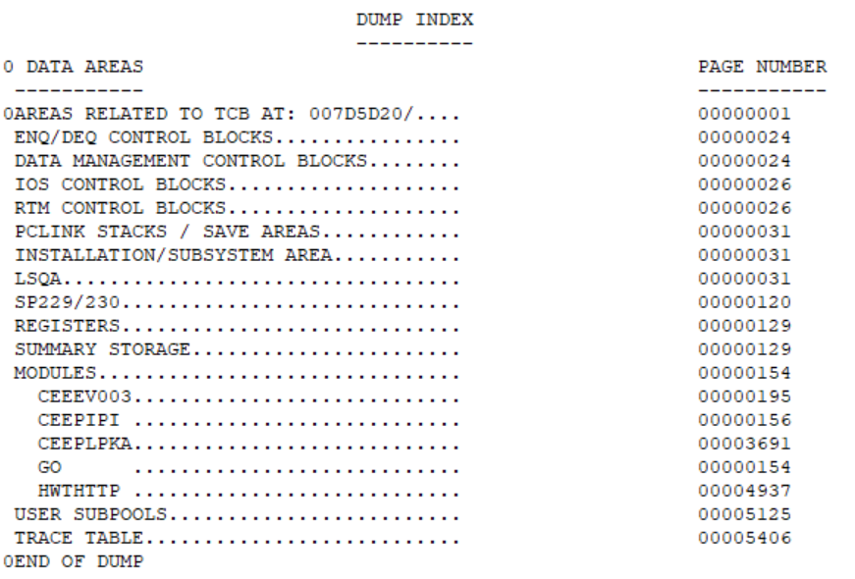
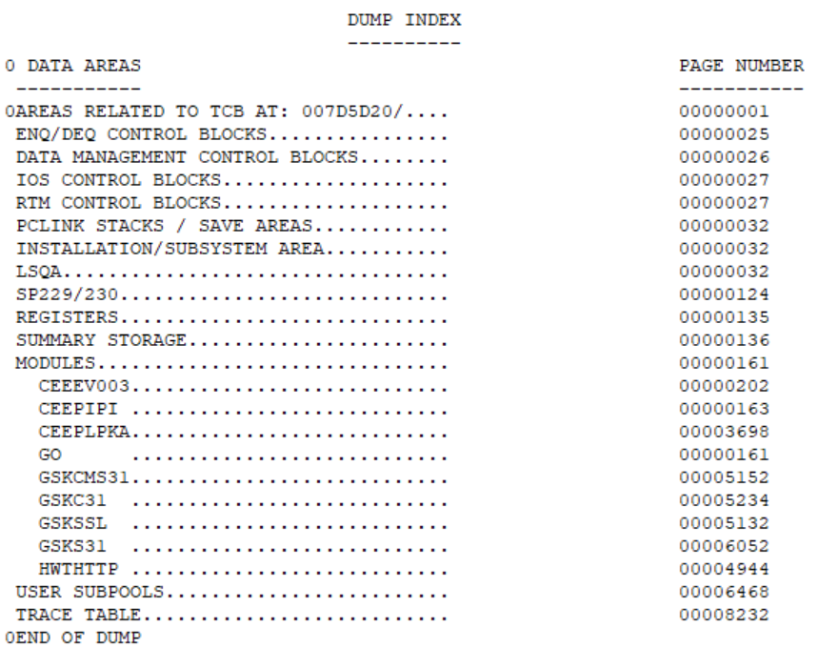











HTTPS is using z/OS System SSL (GSK…..)
HTTP
HTTPS

Slide 20


Setting the HWTH_OPT_USE_SSL option
HWTH_SSL_USE
HWTH_SSL_NONE but HTTPS is used
(AT-TLS: Application Transparent Transport Level Security)
Client Web Application
Client Web Application
RACF/ICSF
HTTPS Enabler (HWTHTTP)
HTTPS Enabler
(HWTHTTP)
RACF Keyring or
Path & file of the key or
PKCS #11 token
AT-TLS Policy
System SSL (GSK….)
Transport (TCP)
PAGENT
AT-TLS
Transport (TCP)
System SSL (GSK….)
IP
IP
HTTPS Server
HTTPS Server

Slide 21
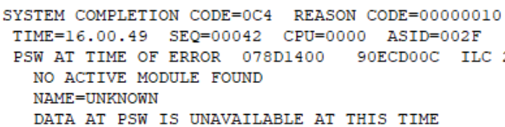






Setting Response Header & Body Callback programs
The manual reads:
HWTH_OPT_RESPONSEHDR_EXIT (non-REXX) An optional 4-byte address of a program to receive control once for each response header received by the application.
HWTH_OPT_RESPONSEBODY_EXIT (non-REXX) An optional 4-byte address of a program to receive control when the response body is received.
LA R2,=A(PROG)
ST R2,OPTIONVALADDR
LA R2,PROG
ST R2,OPTIONVALADDR
Address of PROG
PROG:
The callback program code
PROG:
The callback program code
STM R14,R12,12(R13)

Slide 22
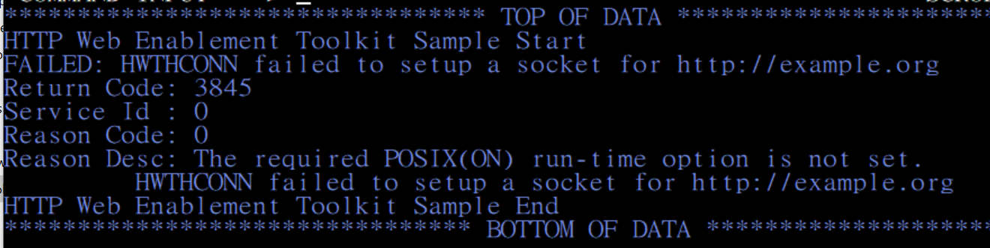
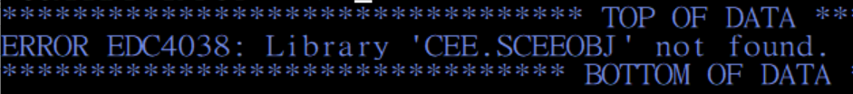
Language Environment: POSIX(ON)
Running Client Web programs needs to set LE POSIX(ON) as the run-time option:
MVS command: SETCEE CEEDOPT,POSIX(ON) to execute a C/COBOL/PLI LMD.
But pre-linking a C program, an error will occur unless SETCEE CEEDOPT,POSIX(OFF)
This can be overcome by one of the following
Using ‘BIND’ instead of ‘PRELINK and LINK’.
Specify POSIX(ON) as the PARM on the run step of JCL for POSIX(ON) only for the individual Address Space
C / PLI : GO.PARM = ‘POSIX(ON) /…’
COBOL: GO.PARM = ‘… / POSIX(ON)’
OMVS segment
also needed
App’s Arguments
App’s Arguments

Slide 23
Using PL/I
PL/I is a strongly typed language.
When the option is HWTH_SLST_NEW to first set up the linked list for header, the pointer to the linked list must be set to 0
I use the following in the program: HTTPSCNW.pli and then ‘Tnum = 0;’
Dcl 1 TMP union,
5 Tnum Fixed Binary(32) Unsigned,
5 Slist Type HWTH_SLIST_TYPE;
But it turns out the correct way to be is ‘Slist = sysnull();’

Slide 24
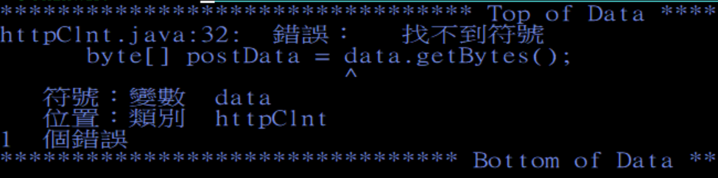
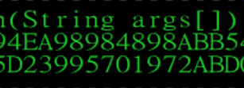

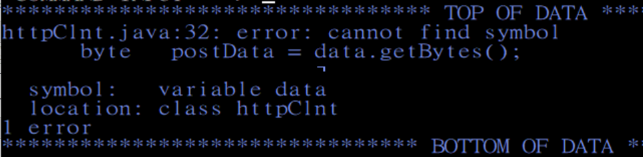
Code conflict while compiling JAVA / C source code in CCSID:937
/etc/profile:
LC_ALL=ZH_TW.IBM-937
Export LC_ALL
In 937 code set
[ is x’BA’,
] is x’BB’
X’AD’,X’BD’ are Not readable in 937 but can be successfully compiled
/etc/profile:
LC_ALL=ZH_TW.IBM-937
Export LC_ALL
Solution for Java : SH javac -encoding IBM-937 -cp /u/andrewj httpTest.java
Code Page | ^ (XOR) | [ | ]
1047 | 0x5F | 0xAD | 0xBD
937 | 0xB0 | 0xBA | 0xBB
Solution for c/c++ : PARM.COMPILE='LOCALE(ZH_TW.IBM-937)'

Slide 25
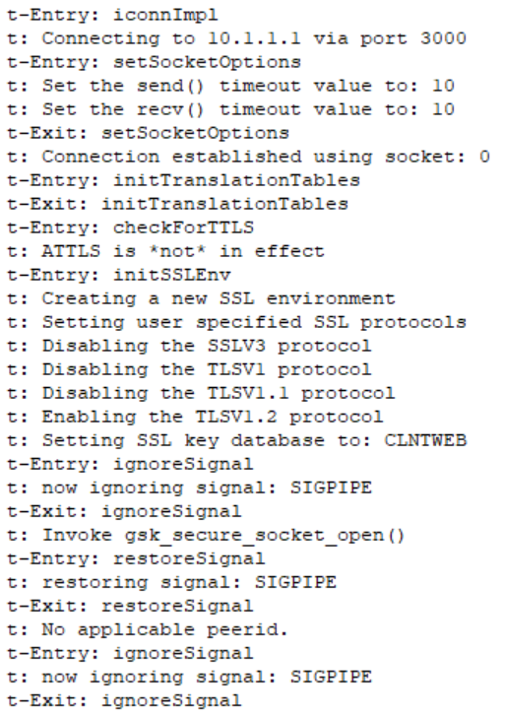
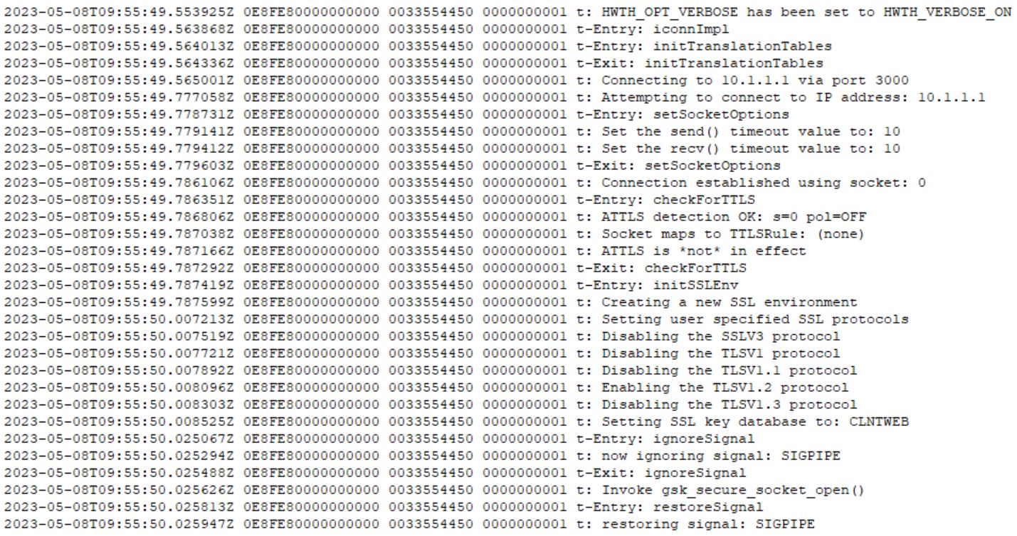
HWTH_OPT_VERBOSE = HWTH_VERBOSE_ON
z/OS 2.2
z/OS 2.4

Slide 26
All source code demonstrated (z/OS)
Client or Server | Platform | Language | Remarks | Source Code
Client | z/OS Batch | REXX | JCL included The SAF keyring must be re-created | HTTPSCNW.rexx
Client | z/OS Batch | Assembler | JCL included (Compile/Link/Run) The SAF keyring must be re-created | HTTPSCNW.asm
Client | z/OS Batch | C | JCL included (Compile/Bind/Run) The SAF keyring must be re-created | HTTPSCNW.c
Client | z/OS Batch | COBOL | JCL included (Compile/Bind/Run) The SAF keyring must be re-created Copy: HWTHICOB.COPY.txt is needed | HTTPSCNW.cob
Client | z/OS Batch | PL/I | JCL included (Compile/Bind/Run) The SAF keyring must be re-created | HTTPSCNW.pli
Client | z/OS Batch | JAVA | Must be run with the ASCII text file:jsondata JAVAC.JCL to compile, JVMJCL86.JCL to run | httpClnt.java
Client | z/OS Batch | JAVA | Must be run with the ASCII text file:jsondata And a CA’s pem file for the server in EBCDIC JAVAC.JCL to compile, JVMJCL86.JCL to run | httpsClnt.java

Slide 27
All source code demonstrated (Windows)
Client or Server | Platform | Language | Remarks | Source Code
Client | VSC (Visual Studio Code) / node cli | JavaScript | Must be run with the server’s CA’s pem file | HttpsClient.js
Client | VSC / python cli | Python | Must be run with the server’s CA’s pem file | HttpsClient.py
Client | Eclipse / java cli | JAVA | Must be run with the server’s CA’s pem file | HttpsClient.java
Client | Visual Studio / exe / dotnet cli | C# | CA’s pem is kept in WIN’s ‘Manage User Certificates’ – Trusted Root Certification Authorities | HttpsClient.cs
Server | Visual Studio / exe / dotnet cli | C# | Support only HTTP ( HTTPS must be set outside of the program - google httplistener-with-https-support ) | HttpServer.cs
Server | VSC / node cli | JavaScript | Use OPENSSL to create the self-signed CA keys and server’s keys | HttpsServer.js
Server | VSC / python cli | Python | Use OPENSSL to create the self-signed CA keys and server’s keys | httpsServer.py
Server | Eclipse / java cli | JAVA | A Java SE 9 & above for ‘com.sun.net.httpserver’ A P12 (PKCS#12 containing the 3 certs) file is needed | httpsSVR.java
Server | mvn cli | JAVA | Open JDK11, Maven (pom.xml auto includes others) The same P12 file is also needed | Liberty_Server.zip

Slide 28
All Demonstrated Source Code files

Slide 29
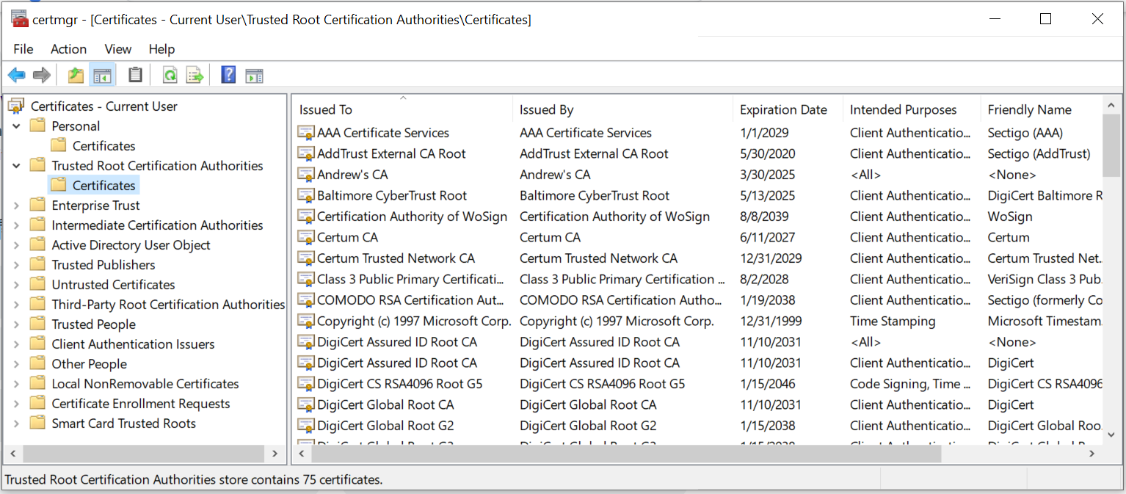
CA key saved for C# on Win
Search for ‘Manage User Certificates’ and activate the panel

Slide 30
CURL
Wsl (Windows Subsystem for Linux):
curl -X POST -H "Content-Type: application/json" -d '{"name": "WSL Ubundu", "age": 7, "email": "wsl.ubundu@example.com", "address": {"street": "123 Main St", "city": "Anytown", "state": "CA", "zip": "2016"}}' https://10.1.1.1:3000/api/data --insecure
‘--insecure’ must be added for HTTPS
PowerShell:
Invoke-WebRequest -Uri "https://10.1.1.1:3000/api/data" -Method POST -Headers @{ "Content-Type" = "application/json" } -Body '{"name": "Power Shell", "age": 17, "email": "power.shell@example.com", "address": {"street": "123 Main St", "city": "Taipei", "state": "Taiwan", "zip": “2006"}}’
Both HTTP (http://10.1.1.1:3001) and HTTPS (https://10.1.1.1:3000) work

Slide 31
SSL on Liberty
src/main/liberty/config/server.xml
Feature
<featureManager> <feature>transportSecurity-1.0</feature> </featureManager>
Keystore: RACF keyring
<keyStore id="defaultKeyStore" location="safkeyring:///WASKeyring" type="JCERACFKS" password="password" fileBased="false" readOnly="true" />
Keystore: file
<keyStore id="defaultKeyStore" location="myKeyStore.p12" password="yourPassword" type="PKCS12"/>

